Slide 1
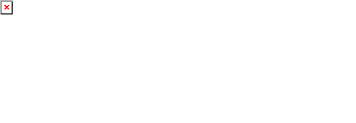
Agent Activity Chart
6/30/2023 3:51 AM
Print User : selenium.automation
Page 1 of 3

Slide 2
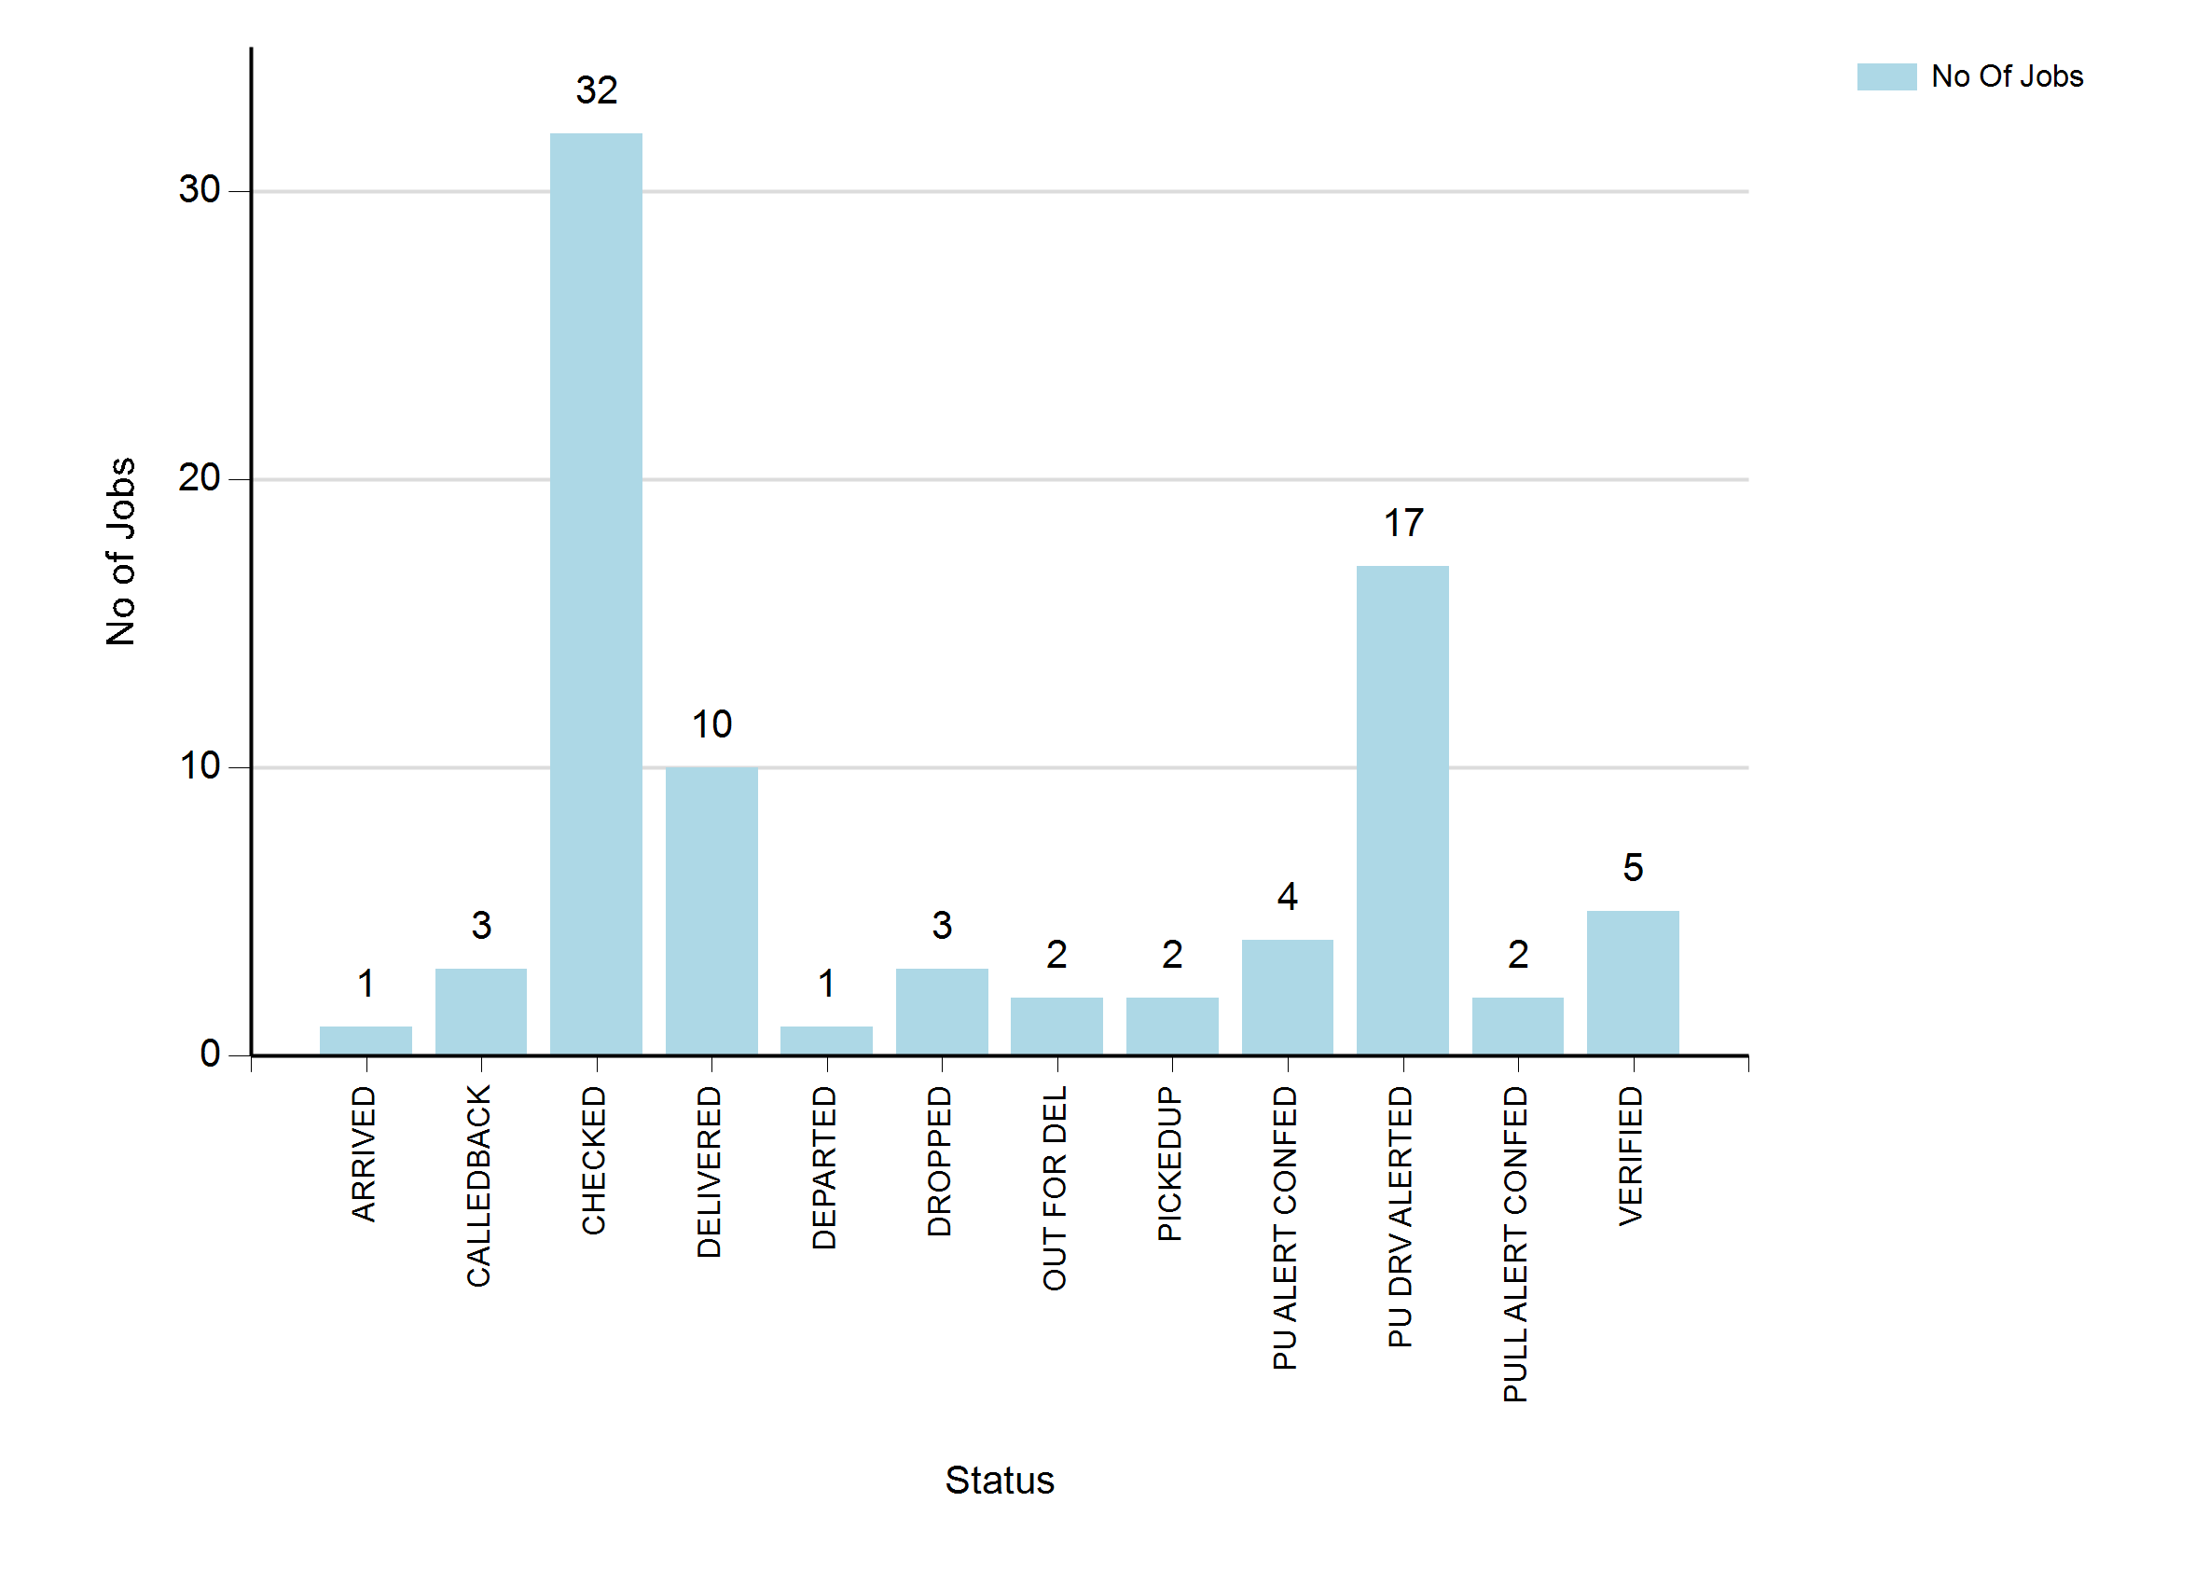
6/30/2023 3:51 AM
Print User : selenium.automation
Page 2 of 3

Slide 3
6/30/2023 3:51 AM
Print User : selenium.automation
Page 3 of 3

